Slide 1
What to do with my old Textbooks?

Slide 2
Current Offerings
College Book Store
Pros:
-Quick and easy process
-No need to ship the book anywhere
Cons:
-Lose a lot of money when selling or buying
eBay & Craigslist
Pros:
-Lots of users to buy your book
-Lots of options when looking for a book to buy
-Lose less money by not having a middleman
-Done right from computer
Cons:
-Need to create account
-Slow process that requires personal information
-Have to usually pay shipping costs

Slide 3
Laker Books

Slide 4
Features
Quick and simple way to buy and sell textbooks from other SUNY Oswego students
No need enter personal and sensitive information
No middleman so more savings for everyone
Done right from the comfort of your computer
Only need to access website once
No registration
Can be used on a variety of devices

Slide 5
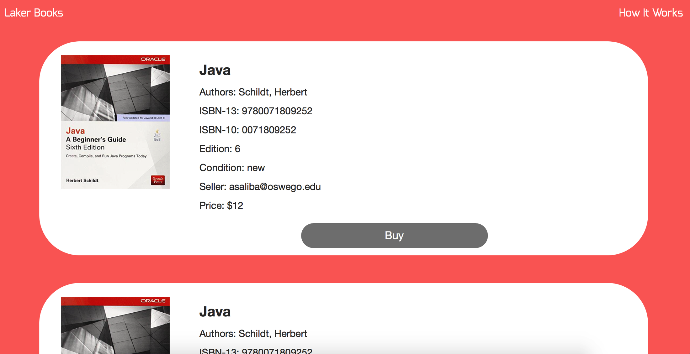
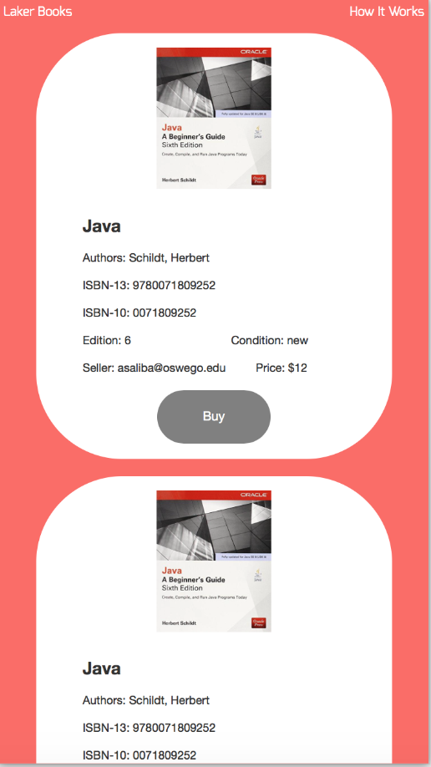
Computer
Mobile Device

Slide 6
Project Timeline
September:
Initial planning
Front end development (HTML, CSS)
Database creation and API use (MySQL, DirectTextbook.com API)
October
Backend (Java, Scala, Play Framework)
Additions to frontend (Bootstrap, JavaScript, jQuery)
November & December
Testing (Usability, Functionality, Fault)
Changes made as a result of testing done

Slide 7
DEMO

